Slide 1



Skin Cancer Classification
Using Deep Learning

Slide 2
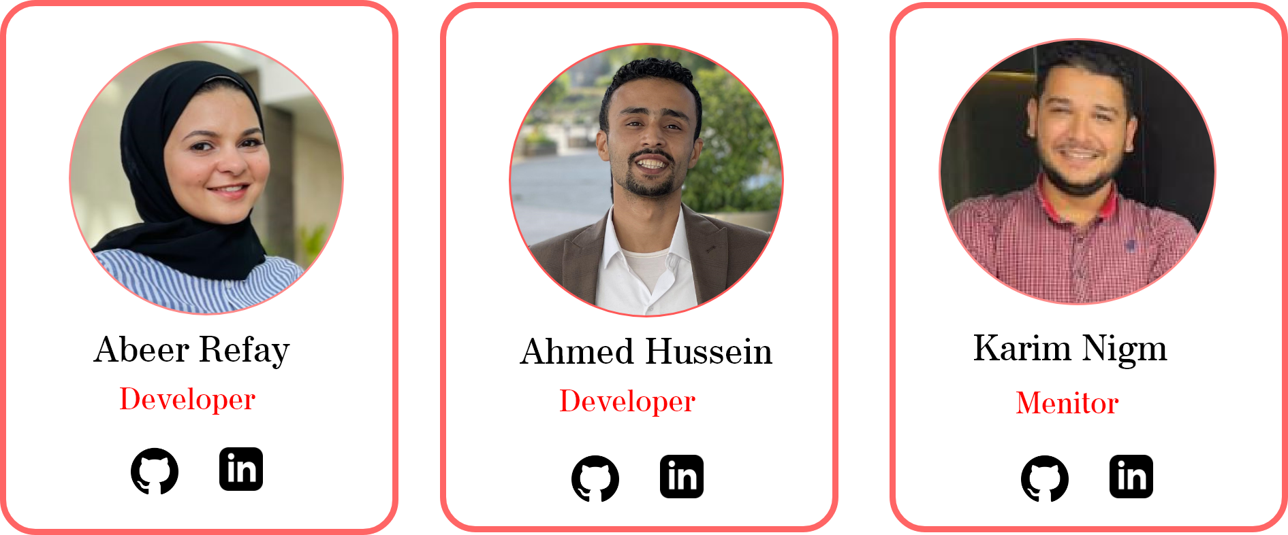
Team

Slide 3
Agenda
Introduction.
Skin cancer.
Skin cancer types.
objective
Project Data.
Dataset.
Data Visualization.
Our Model
API and website
Conculsion and future work.

Slide 4
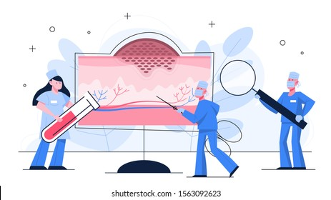
Introduction
Skin Cancer
Cost
Deadliest Cancer
World Health Organization
The annual0 cost of treating skin cancers in the U.S. is estimated at $8.1 billion: about $4.8 billion for nonmelanoma skin cancers and $3.3 billion for melanoma.⁵
Reference [2]
In 2020 10 million person die by cancer .
2.6 million die of skin cancer
Reference [1]
Skin cancer has 40% from total percentage of cancer around the world
Reference [3]
^{WHITE SKIN}
^{SUN}
^{Weak immunity}

Slide 5
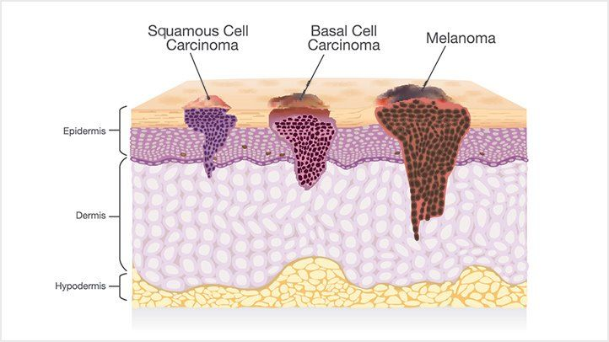
Introduction
Skin Cancer types
1
Basal cell carcinoma
2
Squamous cell carcinoma
3
Melanoma

Slide 6

Objective
Create an online tool that can tell doctors
, Patient and lab technologists the Four highest probability diagnoses for a given skin lesion. This will help them quickly identify high priority patients and speed up their workflow. The app should produce a result in less than 3 seconds.

Slide 7

Objective
Why AI??
01
More Accurate
02
Sava More time and Efforts
03
More Safe in terms of infection

Slide 8


Dataset
The HAM10000 Dataset: A Large Collection of Multi-Source Dermatoscopic Images of Common Pigmented Skin Lesions

Slide 9
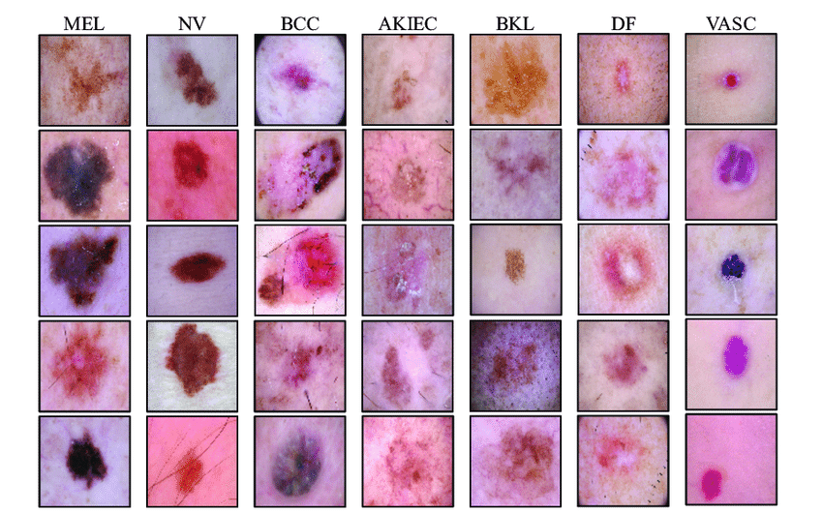
Sample Data
Reference[4]

Slide 10
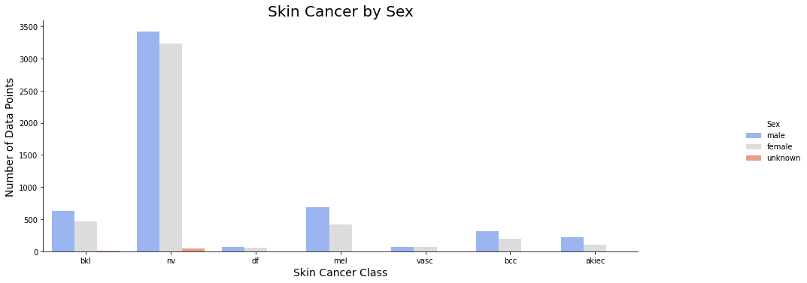
Dataset
The HAM10000 Dataset

Slide 11
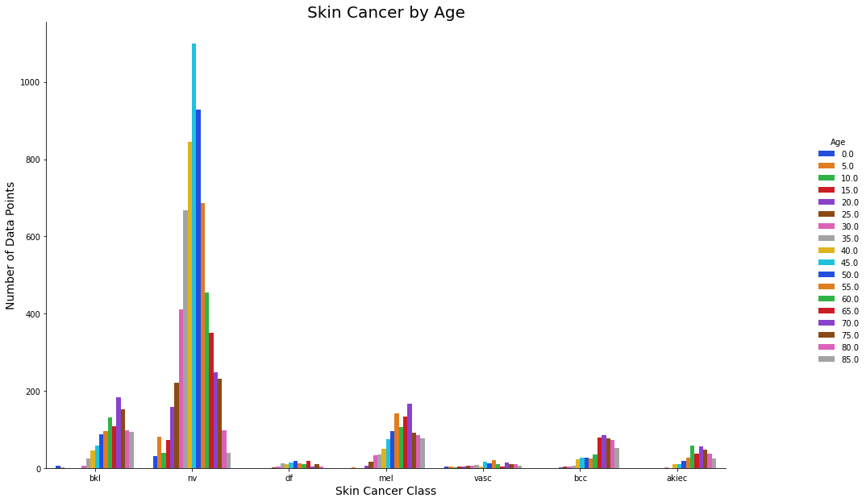
Dataset
The HAM10000 Dataset

Slide 12
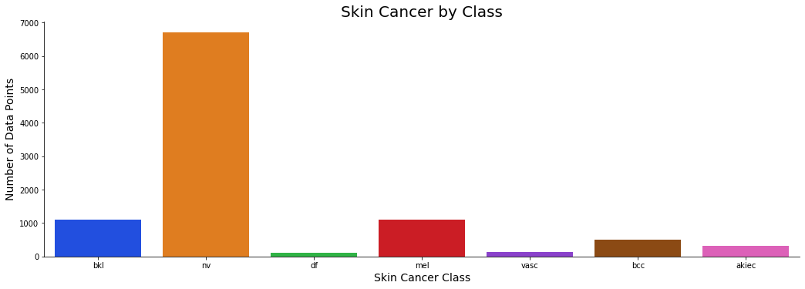
Dataset
The HAM10000 Dataset

Slide 13
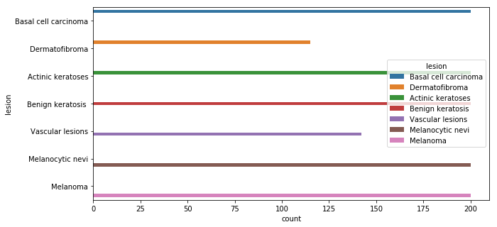
Oversampling using DataAugmentatin
The HAM10000 Dataset

Slide 14
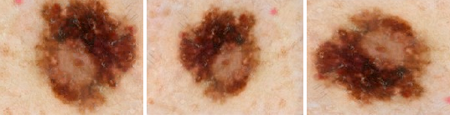
Data Preprocessing
Data Augmentation
rotation_range
width shift
height shift
zoom in
horizontal flip
vertical flip.
filling by the nearest.
Adding droupout rate

Slide 15
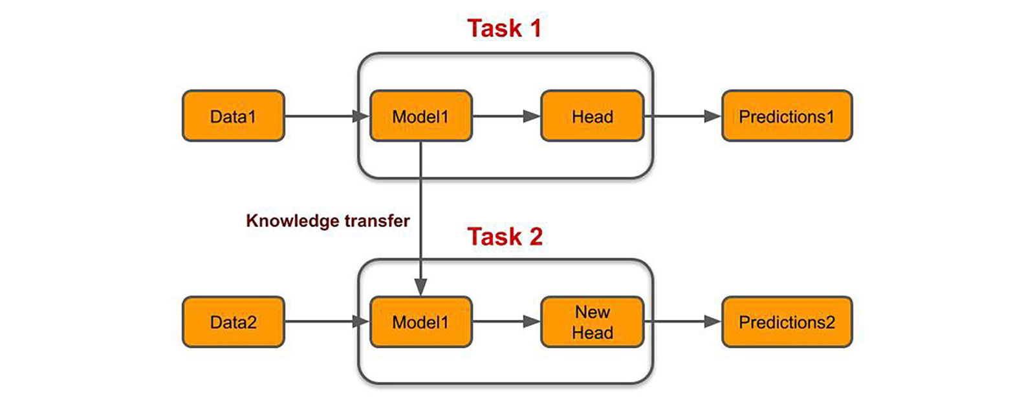
Transfer Learning

Slide 16
Different Models Results
Training and Testing Accuracy
Model | Training Acc | Testing Acc
AlexNet | 92.05 | 88.81
ResNet | 92.78 | 85.20
VGG-16 | 88.83 | 86.09
DenseNet | 91.36 | 85.25
MobileNet | 92.93 | 82.62

Slide 17
Different Models Results
The total time was consumed by each model
Model | Total Time
AlexNet | 24 +/- 1
ResNet | 23 +/- 1
VGG-16 | 24 +/- 1
DesNet | 28 +/- 1
MobileNet | 19 +/- 1
Actual time using Kaggle = 42 +/- 5
Actual time using local machine = 81 +/- 3
Actual time using ITI GPU = 31+/- 5

Slide 18
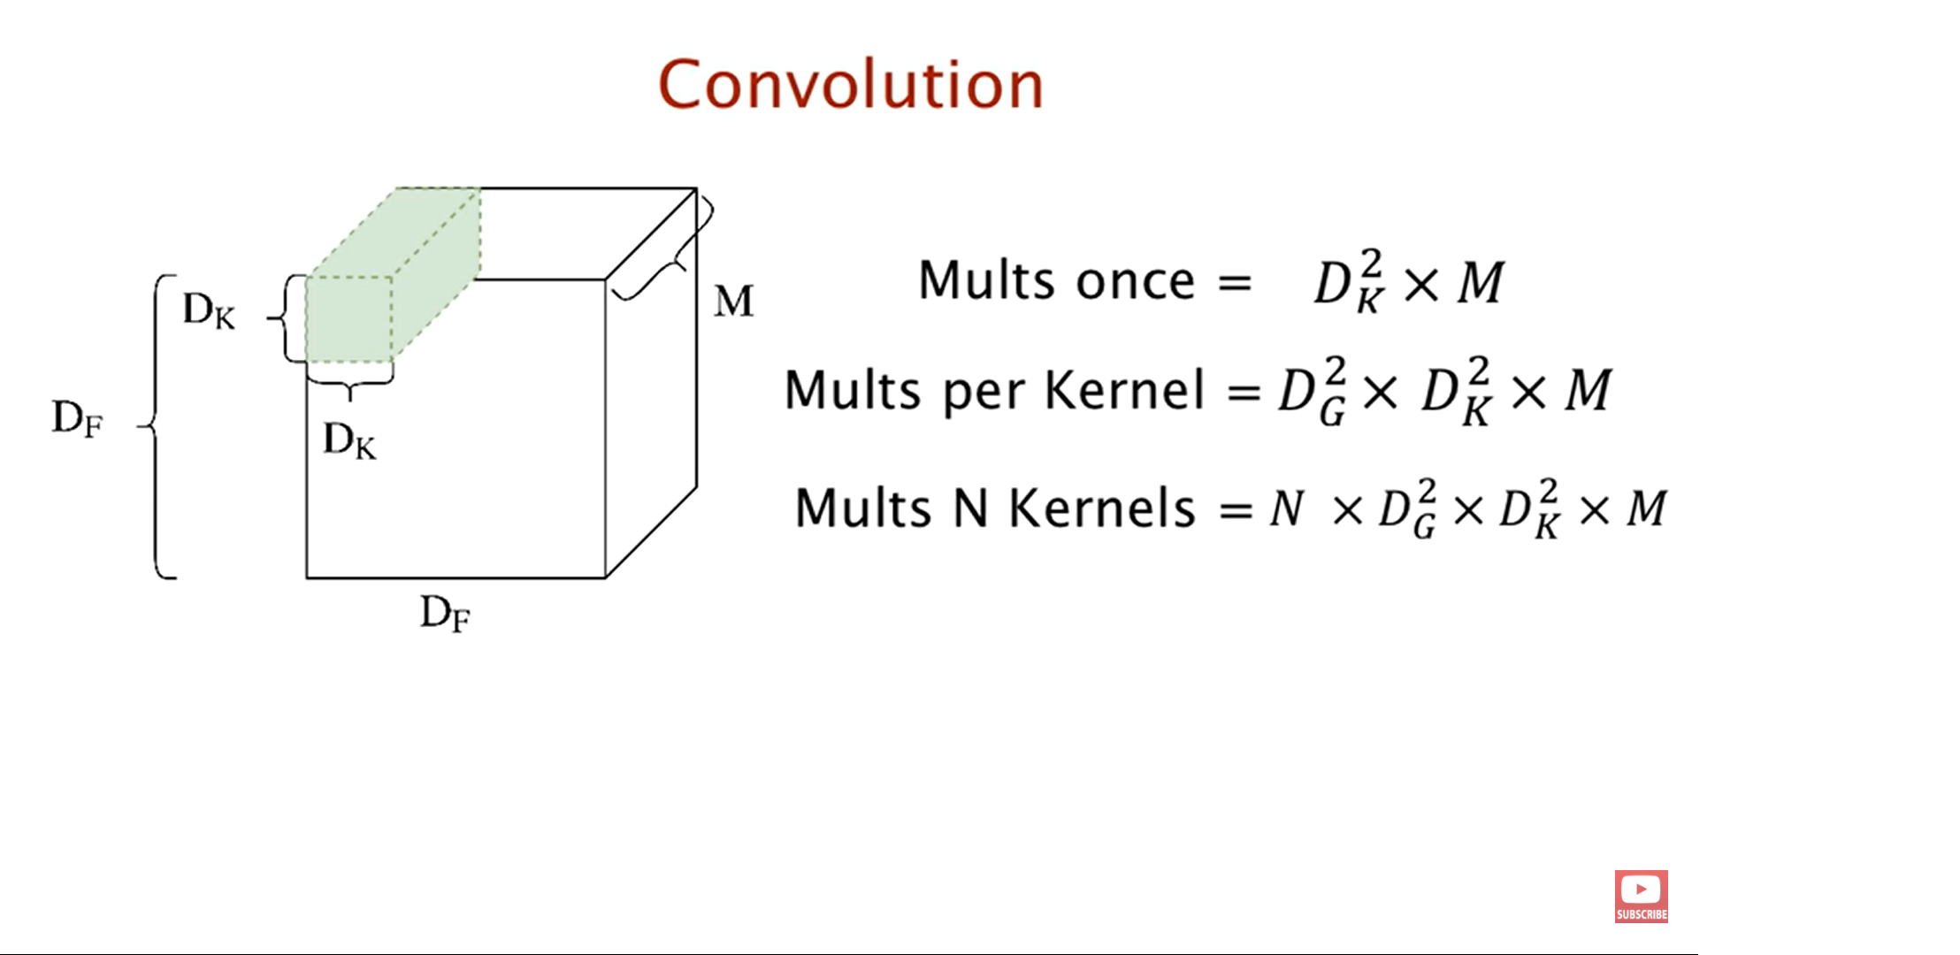
Our Model
Simple CNN (Convolutional Neural Network)
Example: we have,
Dk = 5x5 kernal
M = 3 channel
N = 32 filters.
image size = 12x12
number of movements = 8x8
Dg = 8
the output parameters willl be
5x5x3x8x8x32 = 75 x 64 x 32 = 153.6k

Slide 19
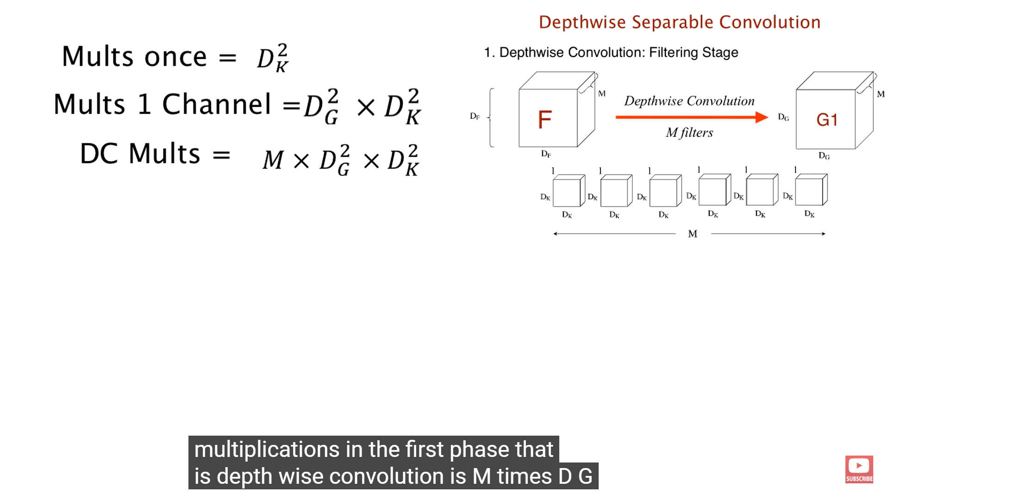
Our Model
Depthwise Convolution: Filtering Stage
DW # of parameters = 3 x 25 x 64

Slide 20
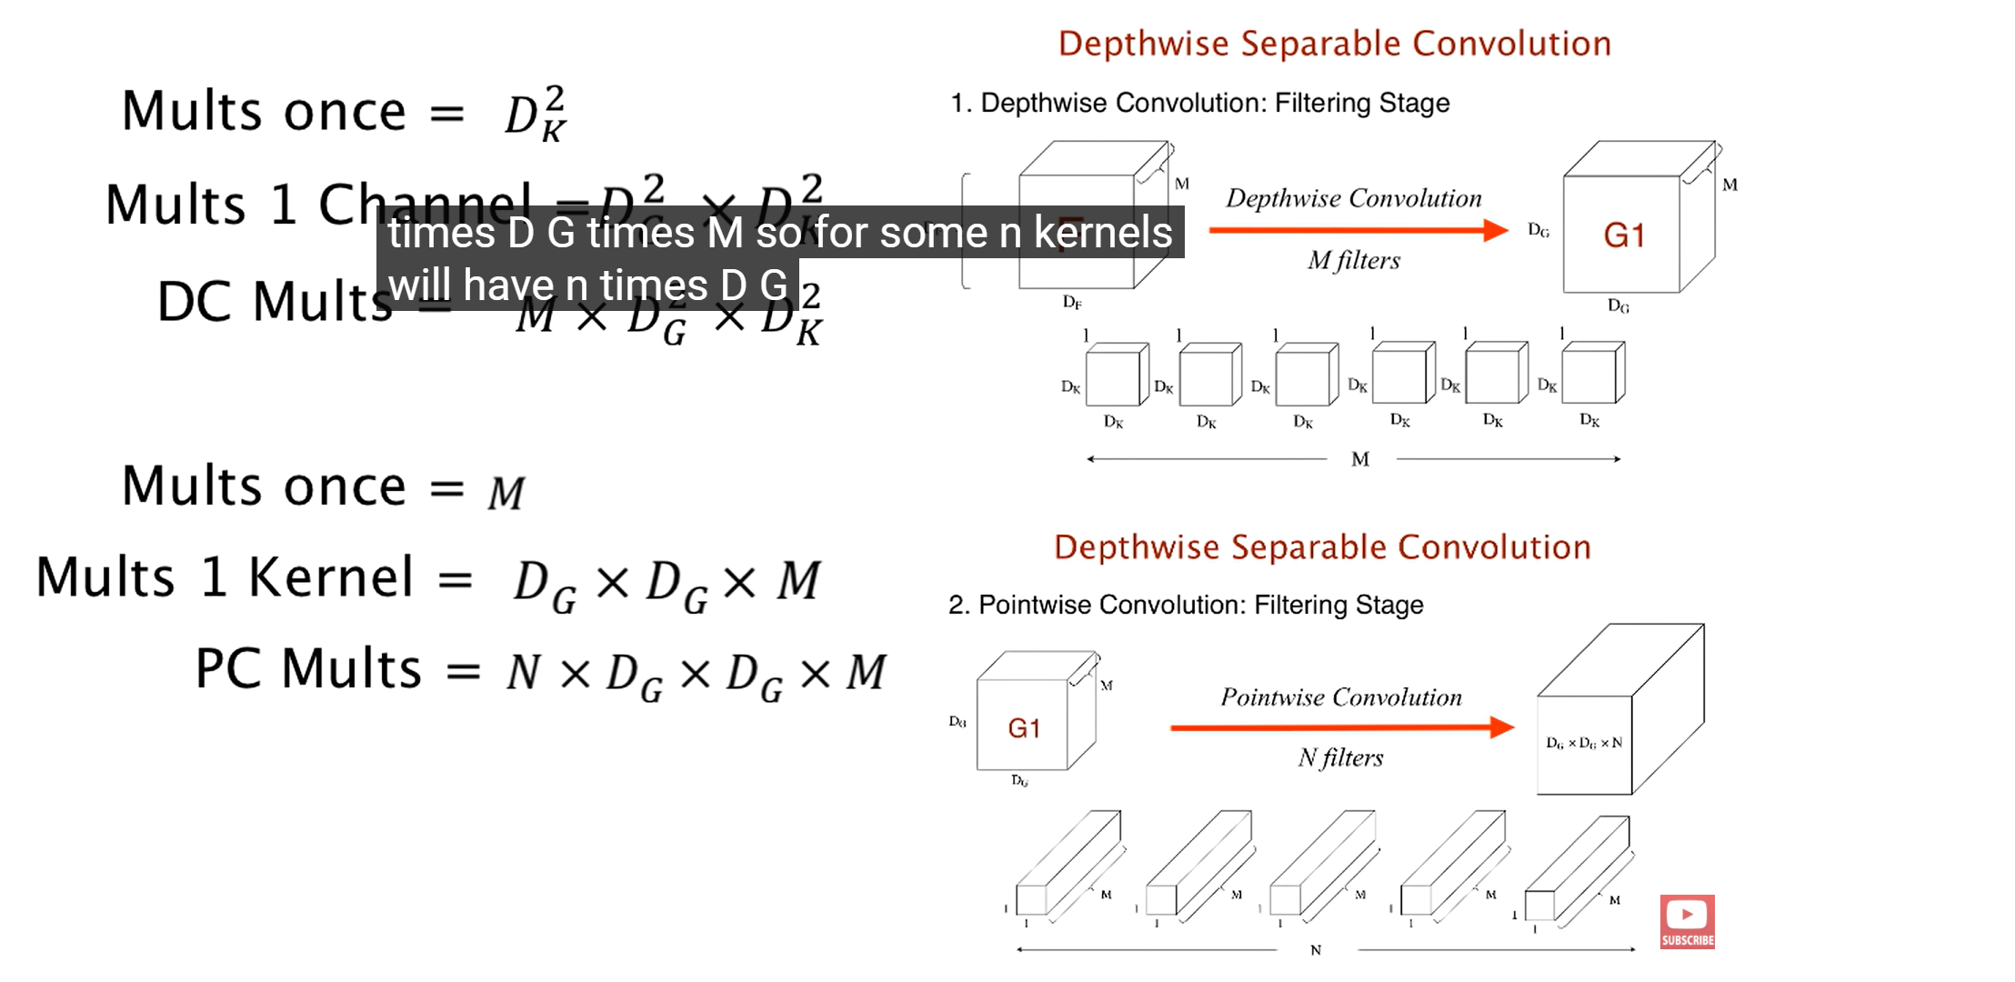
Our Model
Pointwise Convolution: Combining stage
# of parameters = 1 x 1 x 3 x 64 x 32

Slide 21
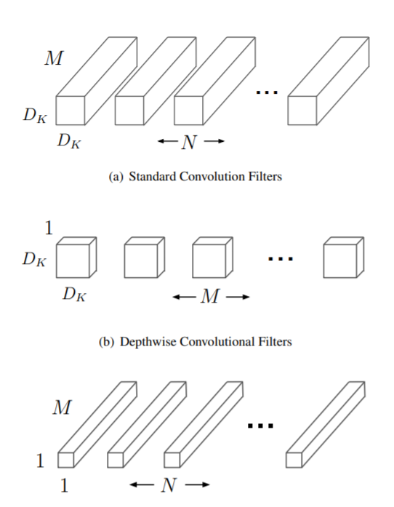
Our Model
Mobilenet Architecture
Total number of Parameters = DW parameters+ PW parameters
3 x 25x 64 + 1x1x3x32x64 = 4800+6144
= 10.944k

Slide 22
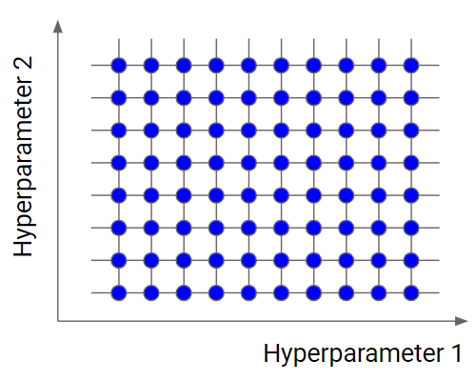
Grid Search
Hyper Parameters Tuning
Exhaustive search over specified parameter values for an estimator.

Slide 23
API
Web API
Flask Framework
JavaScript jQuery
Bootstrap
HTML& CSS

Slide 24
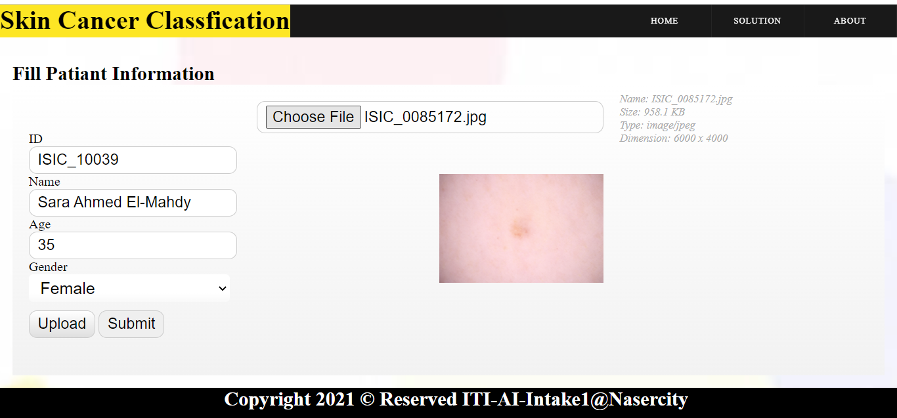
API

Slide 25
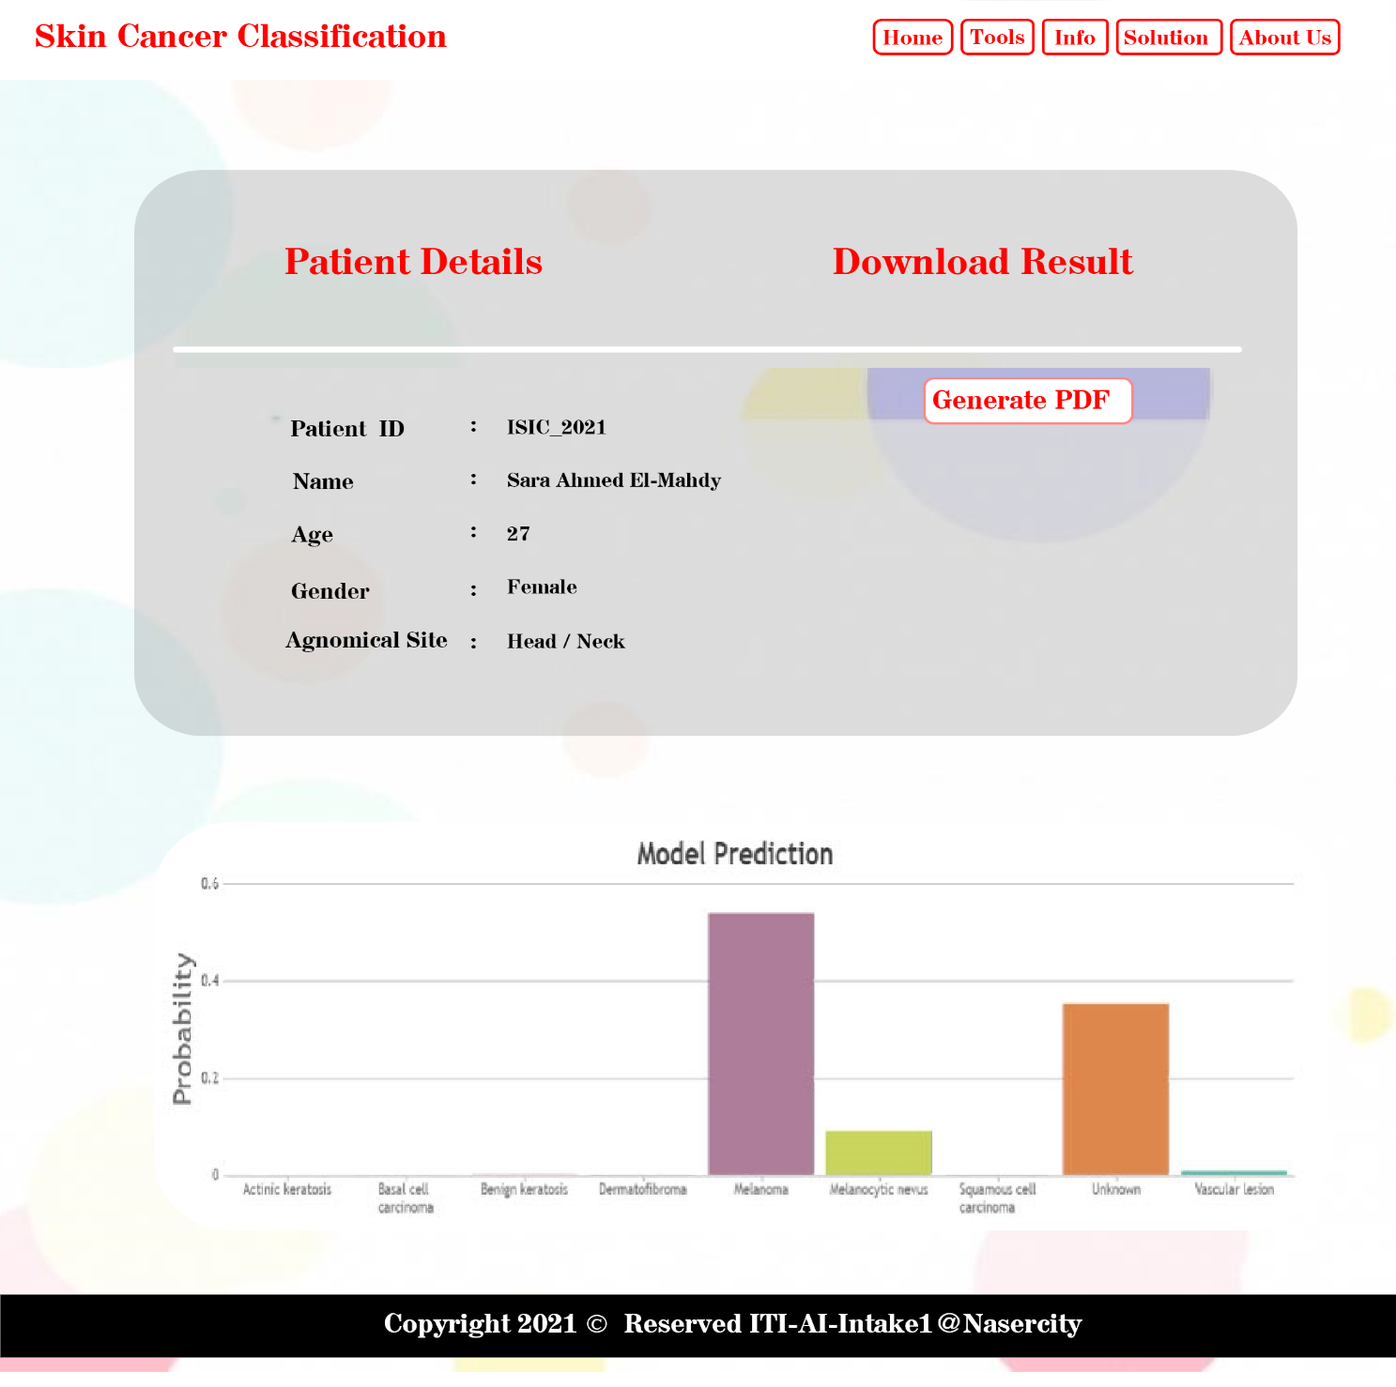
API

Slide 26
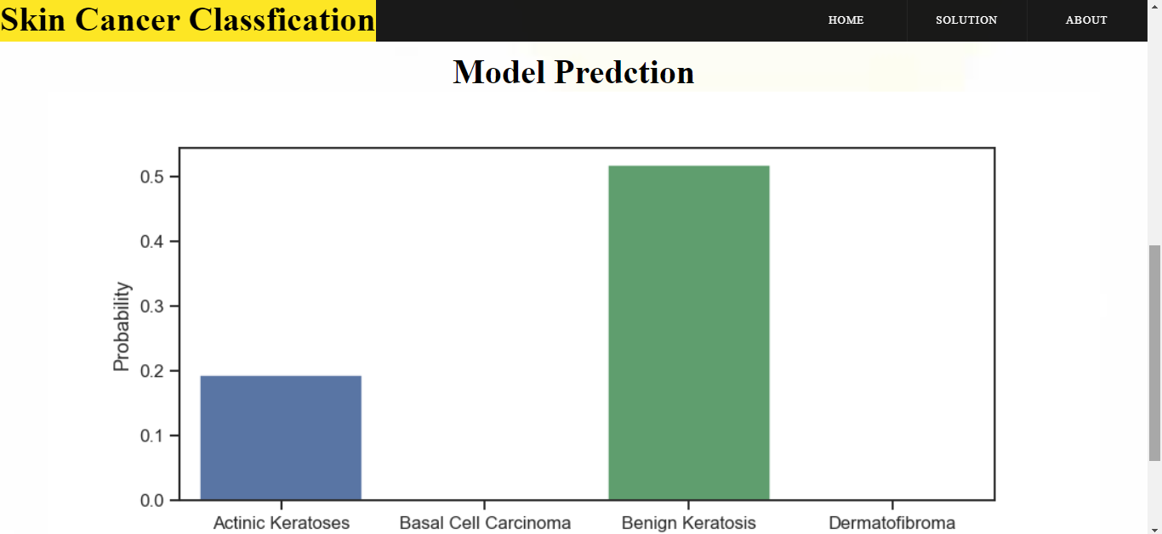
API

Slide 27
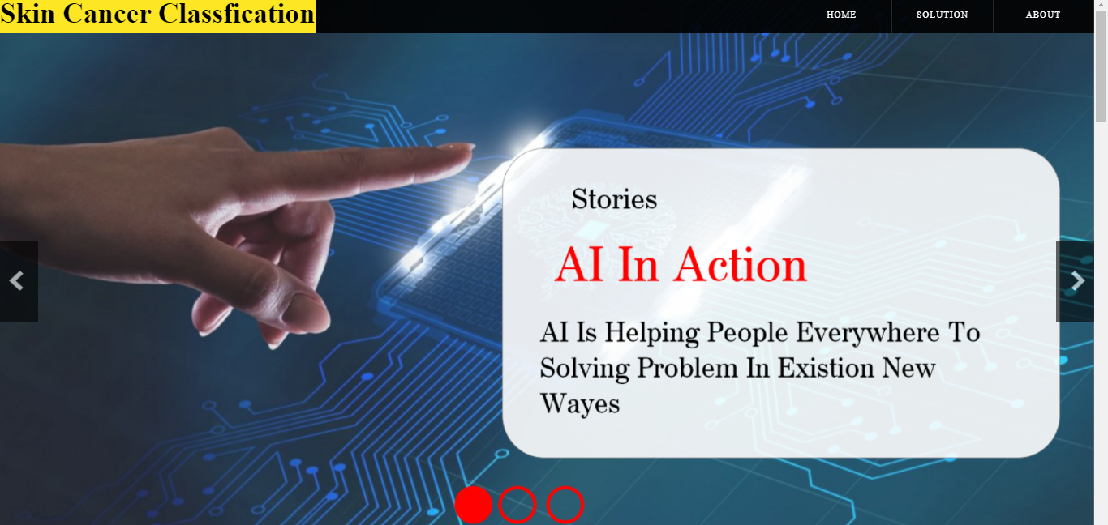
API

Slide 28
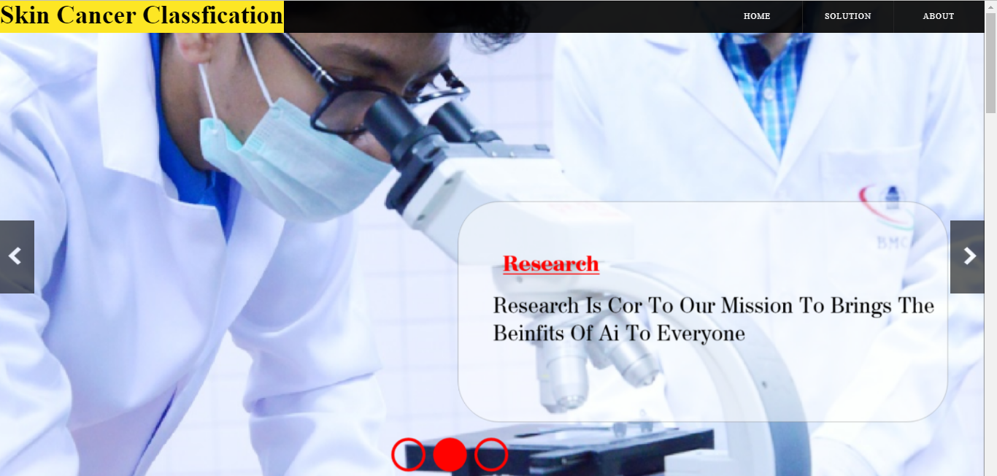
API

Slide 29
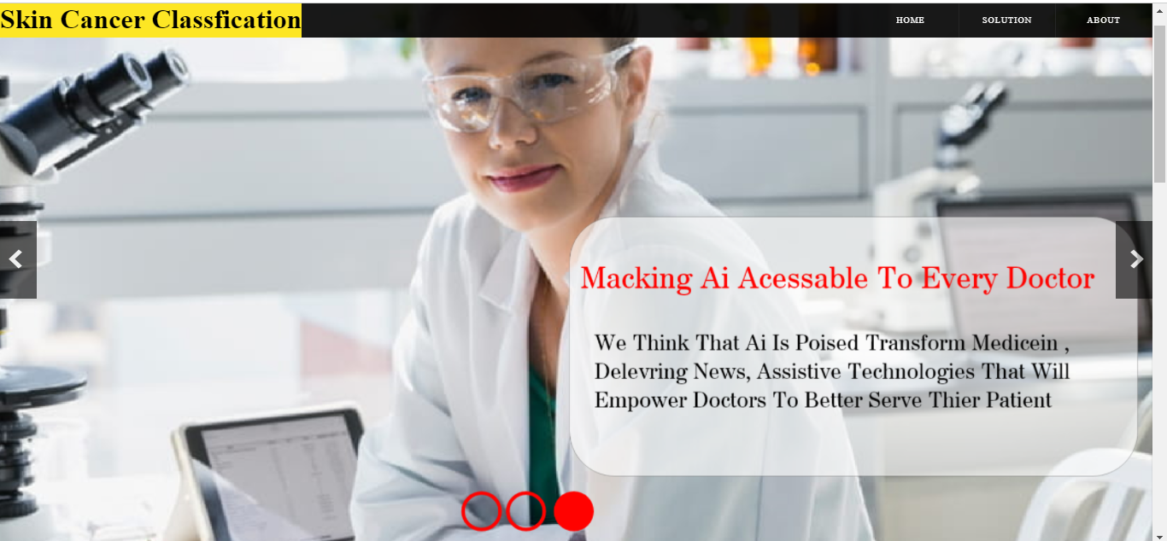
API

Slide 30
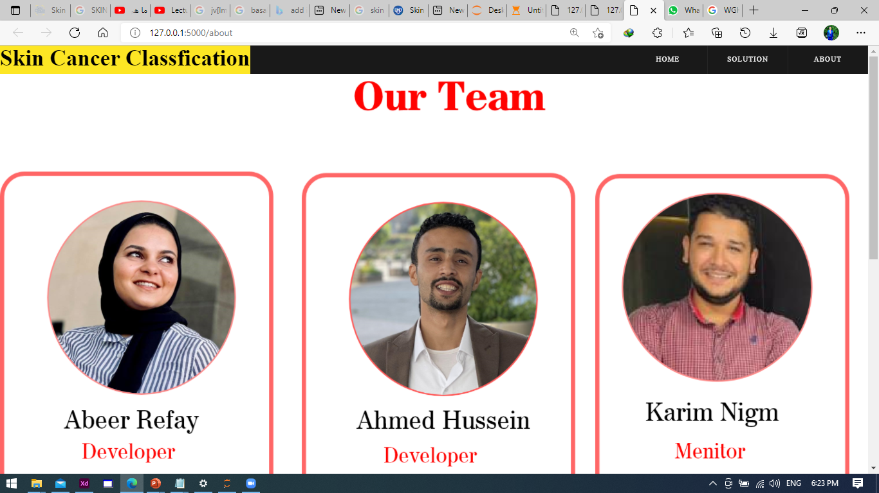
API

Slide 31

Future Work
1
Develop the project to release as mobile application
2
Work on accuracy
3
Working on Larger Datasets with different types of medical images
4
Use it in hospitals

Slide 32

1
Best model to get a validation accuracy is MobileNet with accuracy 82%.
2
Data augmentation improve accuracy of model.
3
Result and efficiency according to previous work and researches was very good.

Slide 33
Any Question?

Slide 34
References
https://arxiv.org/abs/1803.10417
MobileNets: Efficient Convolutional Neural Networks for Mobile Vision Applications
{howarda,menglong,bochen,dkalenichenko,weijunw,weyand,anm,hadam}@google.com
An enhanced technique of skin cancer classification using deep convolutional
neural network with transfer learning models
Md Shahin Ali a, Md Sipon Miah , Jahurul Haque , Md Mahbubur Rahman, Md Khairul Islam
SKIN MELANOMA SEGMENTATION USING RECURRENT AND CONVOLUTIONAL NEURAL NETWORKS
Mohamed Attia, Mohamed Hossny, Saeid Nahavandi, Anousha Yazdabadi.
https://arxiv.org/ftp/arxiv/papers/1911/1911.11872.pdf

Slide 35
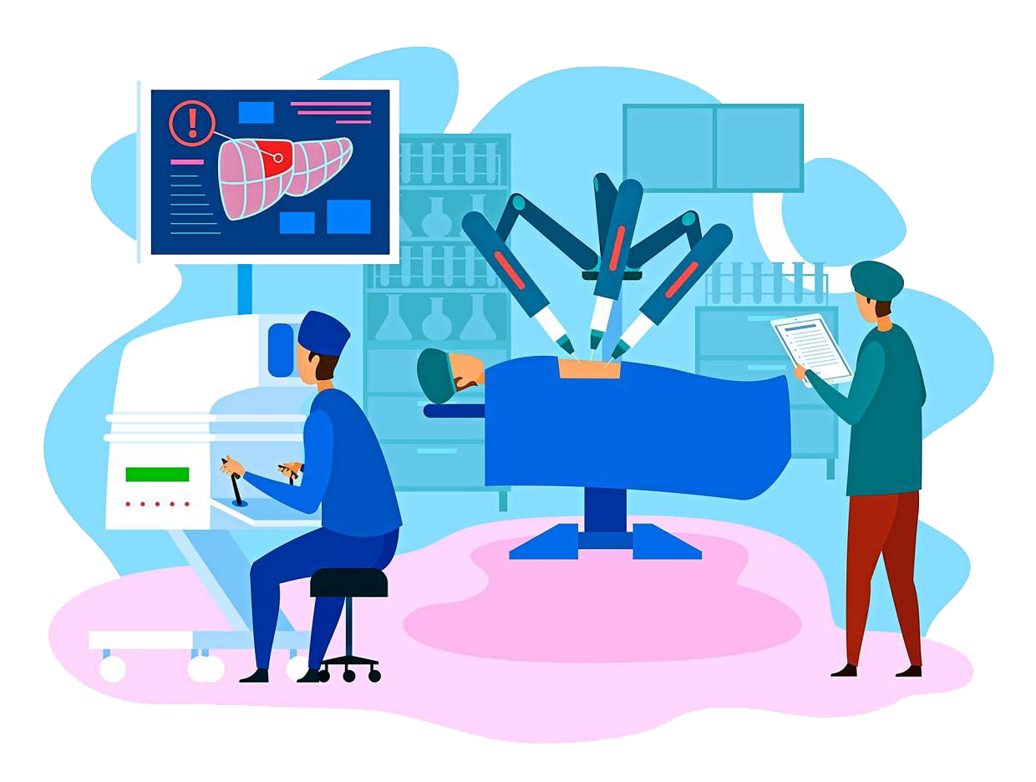
Thank You

